Slide 1
Student's Result
Management System

Slide 2
Introduction
At this moment where the entire world is transformed in the digital world where maximum of daily routine activity is based on computer. But if we talk about our result management system, still we have to go in center's office or need to ask to the respective faculties.
So, In this project we have implemented a computer based system where respective faculties has to upload the marks and the system will show the calculated result to viewers.

Slide 3

In our project "Students Result Management" we will register all the details of the students of a particular course. Likewise it will take the number of courses as input. Accordingly we have to update the marks of the subjects of a student. After taking all the requirements as input, In our project it will generate the student profile. In that profile it will show the students detail, his/her marks and basis of given criteria it will generate the grade also. We can see the course wise students marks and it's statistics respectively.
PROBLEM STATEMENT

Slide 4
1. INTRODUCTION
1.1 Project Purpose
This project is aimed to facilitate the students and teacher to view their academic grades and statistics for their registered courses in a semester. marks are evaluated and maintained by the allotted teachers for the subjects. This provide the facility to view the result anytime and anywhere. The main purpose of this system is to provide an efficient way for maintaining the academic records of the students by the teachers.
SOFTWARE REQUIREMENT SPECIFICATION

Slide 5
1.2 Product Scope
⦁ Stores the student details in the Database.
⦁ Allows student and teacher to login successfully.
⦁ Allows Office Supervisor to view marks and other details of all the enrolled students.
⦁ Allows teacher to add the marks of the students for their respective subjects. On the basis of these marks and other criteria, the Grades will be evaluated.
⦁ Allows the teacher to add or delete student marks from the Database.
⦁ Allows the student to view their marks, grades and other statistics.
⦁ Allows to view course-wise statistics to office supervisor, teacher.

Slide 6
1.3 Deﬁnitions and Acronyms
⦁ Students: A registered individual who visits the this system to view the marks, grades and his/her profile.
⦁ Admin : A registered individual who manages the admin and office supervisor authentication details.
Teacher: Can see course statistics and update student's marks.
Office supervisor: can add and delete student's and course record. Can see course statistics, student profile, available course.
1.4 References and Acknowledgements
⦁ Evaluation of Grade at SCSS Department, JNU, New Delhi- 110067.

Slide 7
2. OVERALL DESCRIPTION
2.1 Product Description
The product is intended to be an improvement on a traditional way of evaluating marks and grades. Therefore, some features like storing the details of the student will be common to existing software, others will be unique. Speed and compatibility are two of the intended areas to be improved allowing the application to run oncomputers with small amounts of memory.

Slide 8
2.2 Product Functionalities
2.2.1 Administrator/Admin(Teacher) module
⦁ This section can be accessed by providing administrator username and password.
Admin can add, delete, see the username and password of admin and Office supervisor(OS).
2.2.2 Official Supervisor module
Official Supervisor is one who can add and delete the student's record.
OS can add and delete the course.
OS can see the all student's or individual student's records.
OS can see the course wise statistics.
2.2.3 Teacher module
A teacher can add the marks of a student of a particular exam.
A teacher can update the marks of a student of a particular exam.
A teacher can see it's course statistics.
2.2.3 Student module
A student can it's can see his/her record only with calculated grade.

Slide 9
2.4 Design and Implementation constraints
⦁ The product is designed and implemented in C language.
⦁ System is platform dependent.
⦁ The information of all the users, students and teachers must be stored in a database that is accessible by the system and the admin.
⦁ Text ﬁles linked with the C program will be used as database.
⦁ Student Record Management System is running 24 hours a day.
⦁ Users must have their correct usernames and subject codes to enter into their accounts and perform further actions.
2.5 Assumptions and Dependencies
The product is platform dependent and can be run on only one device. When using the product it will be assumed that user have some knowledge about computers

Slide 10
3. SPECIFIC REQUIREMENTS
3.1 External Interface Requirements
3.1.1 Hardware Requirements:
⦁ A Computer with Intel Pentium and Celeron class processor.
⦁ Speed : 1.1 GHz.
⦁ RAM : 512MB
⦁ Hard Disk : 4GB space.
⦁ Mouse : Normal
⦁ Keyboard : Normal.
3.1.2 Software Requirements:
⦁ Operating System : Windows XP/7/8/10.
⦁ Database : text ﬁles and C language.
⦁ Frontend : C language.
⦁ Backend : C language.

Slide 11
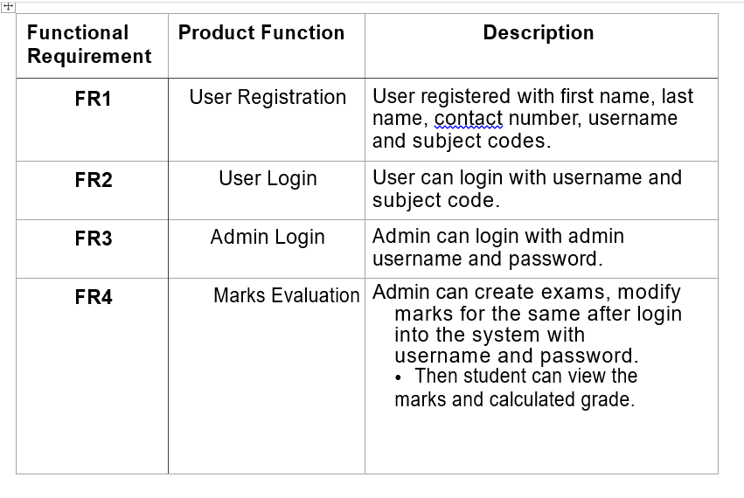
3.2 Functional Requirements :

Slide 12
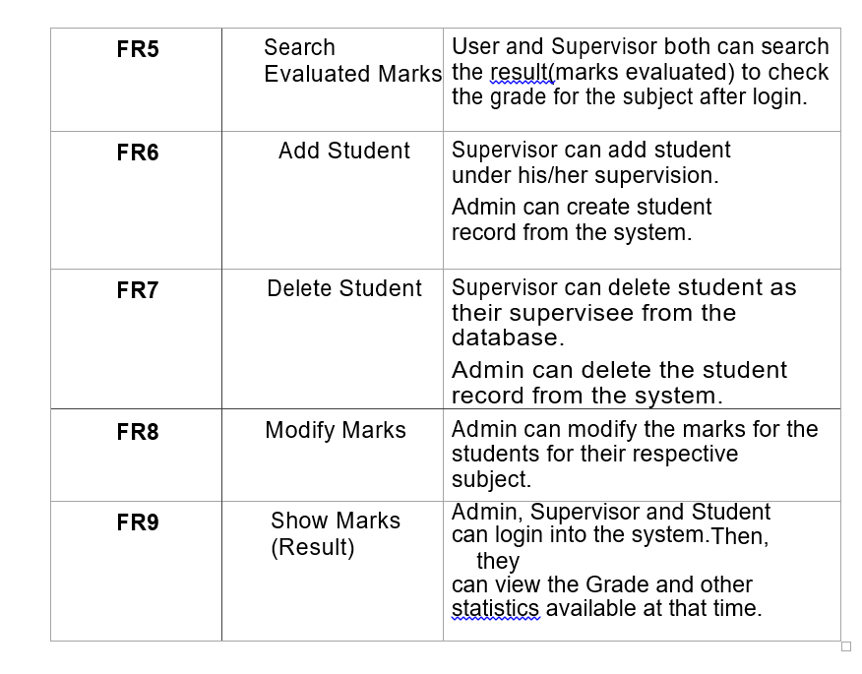
3.2 Functional Requirements :

Slide 13
4. Non Functional Requirements
4.1 Security
⦁ The system’s database shall only be accessible to authenticated administrators.
⦁ Sensitive data will be encrypted before being recorded.
4.2 Reliability
⦁ The reliability of the overall program depends on the reliability of separate components.
⦁ The main pillar of the reliability of the system is the database which is continuously maintained and updated to reﬂect the most recent changes.
⦁ Thus the overall stability of the system depends on its underlying operating system.

Slide 14
Conti...
4.3. Availability
⦁ The system should be available at all the times, meaning the user can access
it anytime.
⦁ In case of hardware failure or database corruption, backups of the database
should be retrieved and saved by the administrator.
4.4 Maintainability
⦁ In case of failure, a re-initialization of the program shall be done.
⦁ Also the product design is being done with modularity in mind so the
maintainability can be done efficiently.

Slide 15
DESIGN DOCUMENT
1.DATA FLOW DIAGRAM:
A Data Flow Diagram (DFD) is a traditional way to visualize the information flows within a system. A neat and clear DFD can depict a good amount of the system requirements graphically. It can be manual, automated, or a combination of both.
It shows how information enters and leaves the system, what changes the information and where information is stored. The purpose of a DFD is to show the scope and boundaries of a system as a whole. It may be used as a communications tool between a systems analyst and any person who plays a part in the system that acts as the starting point for redesigning a system.

Slide 16
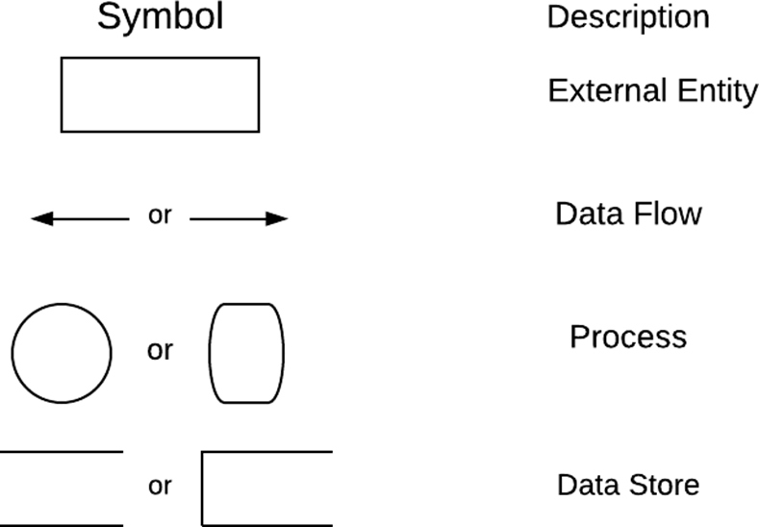
The symbols used in a DFD are as follows:

Slide 17
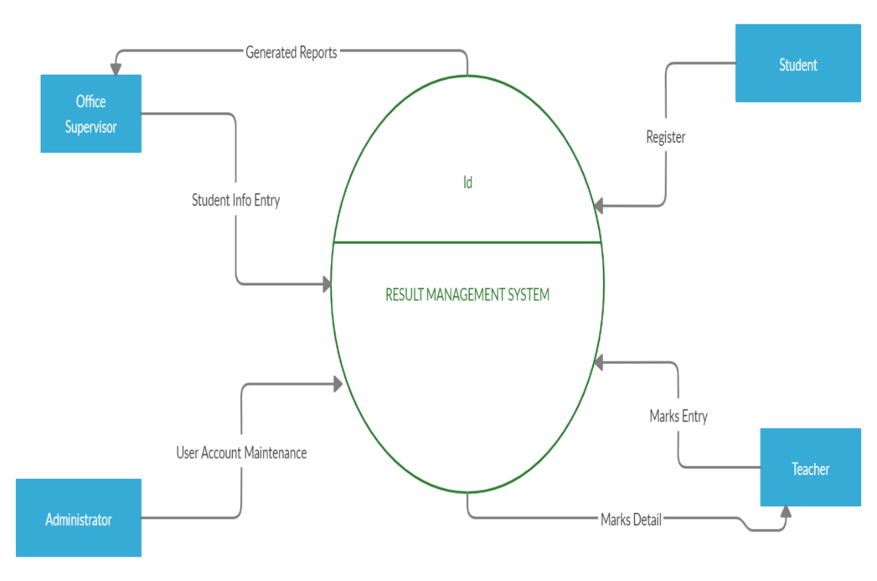
Level-0 DFD

Slide 18
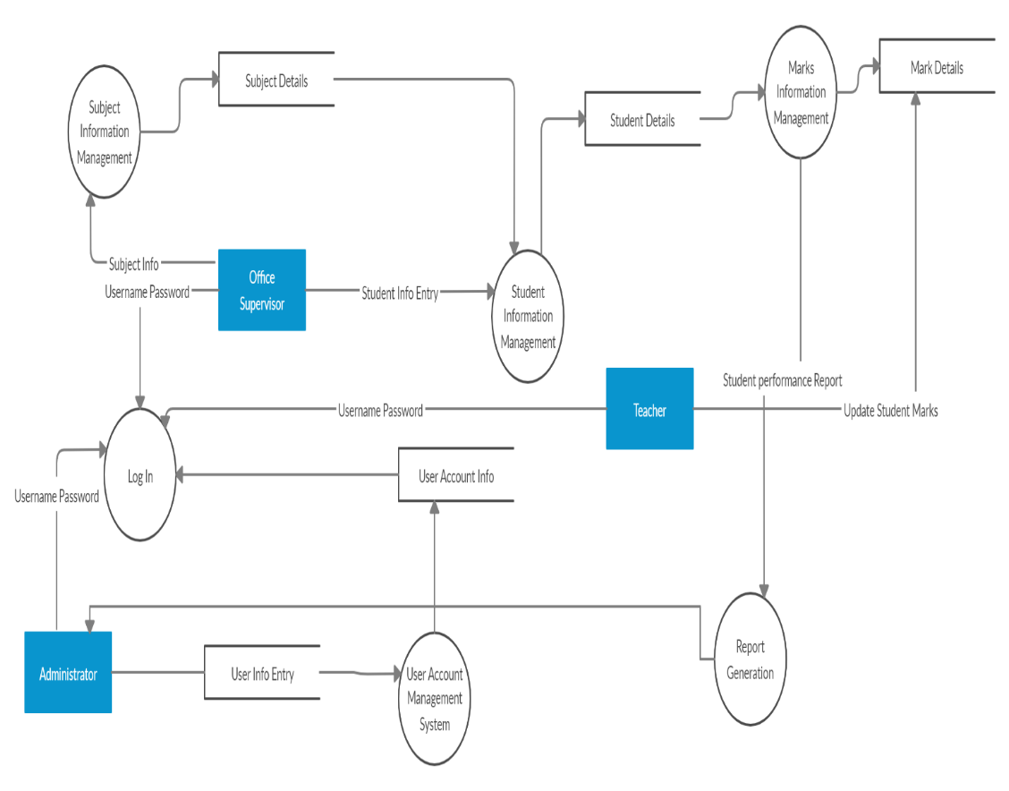
Level-1 DFD

Slide 19
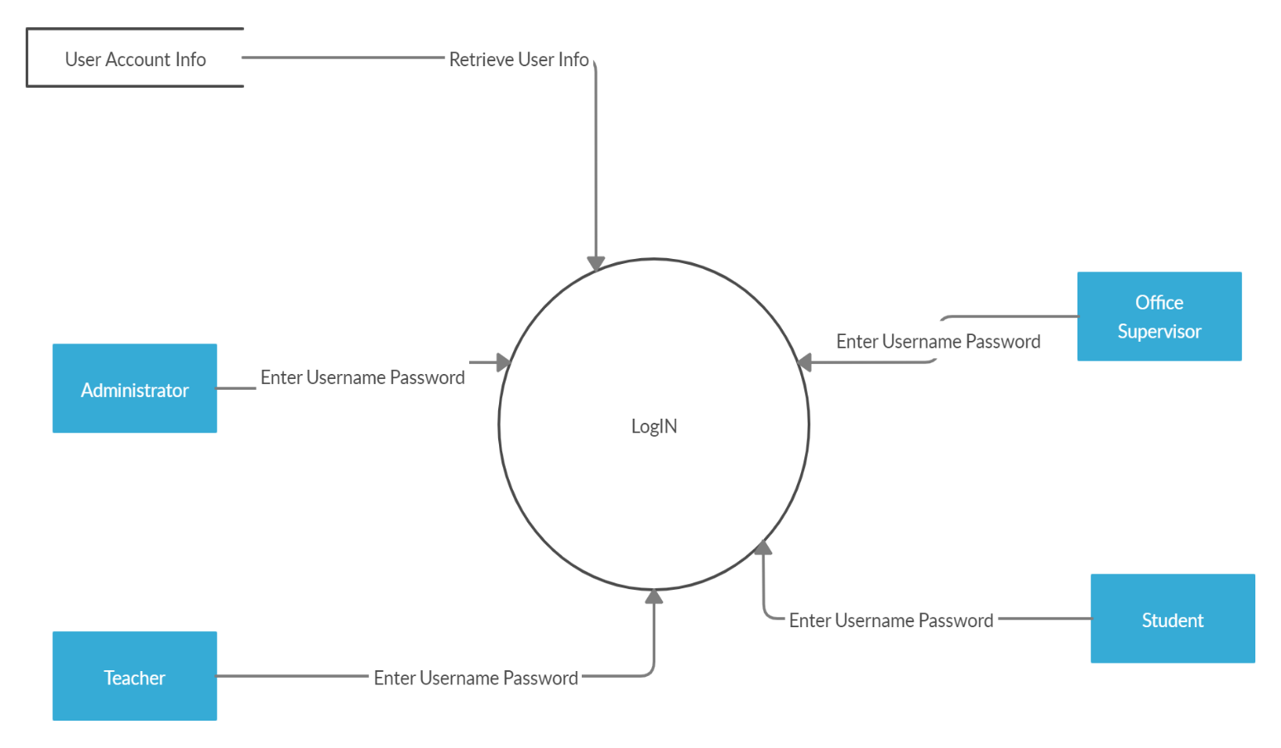
Level-2 DFD of Login

Slide 20
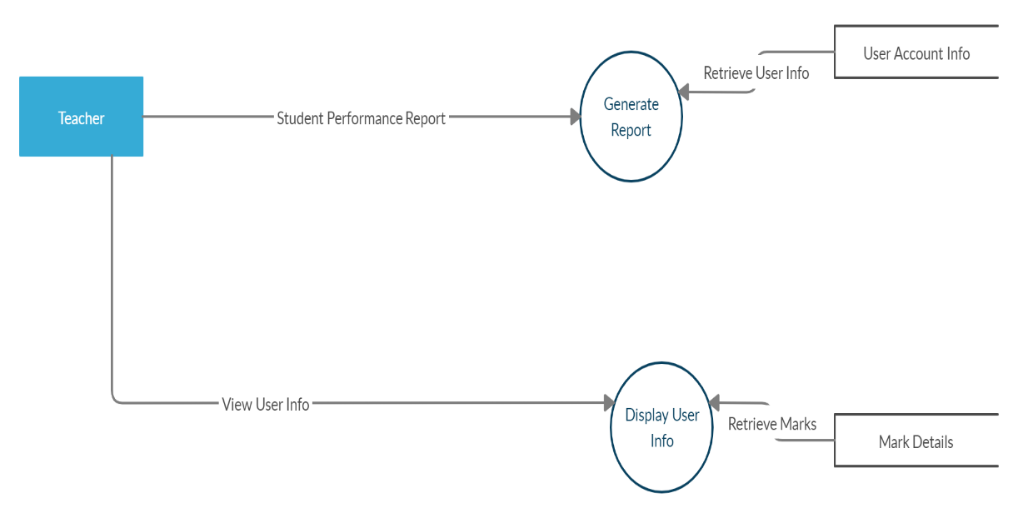
Level-2 DFD of User Account Maintenance

Slide 21
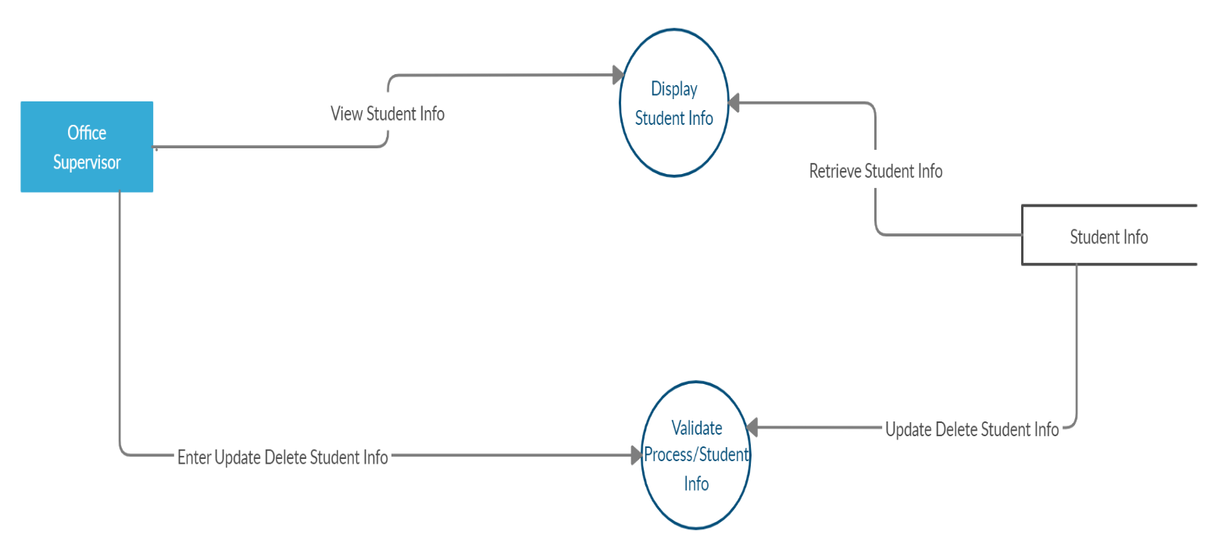
Level-2 DFD of Student Information Management

Slide 22

2.PROCESS SPECIFICATION
It defines what must be done in order to transform the inputs to outputs. A process must be expressed in a form that can be verified by the user and the system’s analyst. It should also be designed such that it can be effectively communicated to the various audiences involved.

Slide 23
2.1 Using Structured English
It is basically English with structure. Its purpose is to strike a reasonable balance between the precision of a formal programming language and the casual informality and readability of the English language.

Slide 24
Process Specification:-
1.OS
1. Create student's profile
OPEN CreateStudentProfile()
OPEN Student file in append mode.
INPUT name, dob, enroll, Program name, mobile no, email, password.
WRITE into file if enroll is not exist.
END CreateStudentProfile().

Slide 25
2. Display Student profile()
OPEN showAllStudents()
PRINT student's name, dob, enroll, Program name, mobile no, email, password.
PRINT student's obtained marks.
END showAllStudents()
3. Add new course
OPEN createCourse()
OPEN course file in append mode.
INPUT course code, course name, course description, course password.
WRITE into file if enroll is not exist.
END CreateStudentProfile().

Slide 26
4. Delete all students profile
OPEN DeleteAllStudentsRecord()
OPEN student.dat file in writing mode.
END DeleteAllStudentsRecord()
5. See Available course
OPEN showCourse()
OPEN course.dat file in read mode.
LOOP UNTILL course ends in file
PRINT course code, course name, course description.
ENDLOOP
END showCourse()

Slide 27
6. Delete all course
OPEN DeleteAllCourses()
OPEN new course2.dat file in writing mode.
OPEN new course.dat file in writing mode.
REMOVE course.dat file.
RENAME course2.dat file to course.dat file
END DeleteAllCourses()
7. See course wise statistics
OPEN Course_wise_statistics() with course code as parameter.
OPEN student.dat file in reading mode.
LOOP Until all student records has been read.
Calculate all total obtained marks of every student. And call calculate_grad() function to calculate grade.
CLOSE student.dat.
END Course_wise_statistics().

Slide 28
2. TEACHER
1. Add Marks
OPEN AddingMarks()
OPEN students.dat file in writing mode.
OPEN students2.dat file in writing mode.
INPUT which exam marks teacher is going to add.
LOOP read all student form students.dat one by one.
INPUT student's marks respectively.
WRITE student's marks in student2.dat file.
ENDLOOP
REMOVE students.dat file.
RENAME student2.dat file to student.dat
END AddingMarks()

Slide 29
2. Update marks
OPEN UpdateMarks()
OPEN students.dat file in writing mode.
OPEN students2.dat file in writing mode.
INPUT which exam marks teacher is going to add.
INPUT which student's marks teacher is going to update.
LOOP read all student form students.dat one by one.
IF student is found as givent enrollment number
INPUT student's marks respectively.
ENDIF
WRITE student's marks in student2.dat file.
ENDLOOP
REMOVE students.dat file.
RENAME student2.dat file to student.dat
END UpdateMarks()

Slide 30
3. See course wise statistics
OPEN Course_wise_statistics() with course code as parameter.
OPEN student.dat file in reading mode.
LOOP Until all student records has been read.
Calculate all total obtained marks of every student. And call calculate_grad() function to calculate grade.
CLOSE student.dat.
END Course_wise_statistics().

Slide 31
3. STUDENT
1. See student profile
OPEN showSigleStudentByStudent()
OPEN student.dat file in read mode.
INPUT student's enrollment number
CHECK IF student's enrollment number is exist.
ENDIF
INPUT student's password.
CHECK IF student's password is correct.
PRINT student's name, dob, enroll, Program name, mobile no, email, password.
PRINT student's obtained marks.
ENDIF
END showSigleStudentByStudent()

Slide 32
4. ADMIN
1. Create login profile
OPEN create login profile().
OPEN loginfile.dat file in write mode.
INPUT whom profile credential you are going to enter ex: teacher.
INPUT username and password.
WRITE it into loginfile.dat file.
CLOSE loginfile.dat file.
END
2. Login function
OPEN loginfunction()
OPEN loginfile.dat file in read mode.
INPUT whom profile credential you are going to enter ex: teacher.
INPUT username and password.
Check whether username and password are correct.
RETURN TRUE if credential are true else false;
END

Slide 33

2.2. PRE AND POST CONDITIONS
It is a convenient way to describe the function without considering the algorithm and procedure to be used.
There are two main parts: PRE-Condition and POST Condition.
PRE-CONDITION:
⦁ Describes what must be true before the process begins operating.
⦁ It describes what input must be available.
⦁ It describes what relationship must exist among inputs.
⦁ It describes relationship between inputs and data stores.
POST CONDITION:
⦁ Describes what must be true when a process has finished operating.
⦁ It describes the output that must be generated by the process.
⦁ It describes the relationships that must exist between the output values and the original input values.
⦁ It describes output values in one or more stores.
⦁ It describes changes made to the stores.

Slide 34
1.OS
1. Create student's profile()
Pre - condition:- Open students.dat file and the enter name, dob, enroll, Program
name, mobile no, email, password.
Post - condition:- Write into student.dat file after taking name, dob, enroll,
Program name, mobile no, email,password as input.

Slide 35
2. Display Student profile()
Pre - condition:- Open students.dat file.
Post - condition:- Display name, dob, enroll, Program name, mobile no, email,
password on screen.
3. Add new course()
Pre - condition:- Open course.dat file in writing mode and then enter course code,
course name, course description, course password.
Post - condition:- write into course.dat file after taking course code, course name,
course description, course password as input.

Slide 36
4. Delete all students profile()
Pre - condition:- Open students.dat file in writing mode.
Post - condition:- Close student.dat file without write anything.
5. See Available course()
Pre - condition:- Open course.dat file in reading mode.
Post - condition:- Print all available course on course.dat file using loop.

Slide 37
6. Delete all course
Pre - condition:- Open course.dat in writing mode and a new file course2.dat in writing mode.
Post - condition:- Now rename course2.dat as course.dat file.
7. See course wise statistics
Pre – condition:- Open students.dat file in reading mode. Read every student's obtained marks one by one. Calculate grade.
Post - condition:- Display the student record their grades.

Slide 38
2. TEACHER
1. Add Marks
Pre - condition:- Open students.dat and students2.dat in writing mode. Input which exam marks that teacher is going to add. Using loop read every student's record one by one from students.dat and add marks and write back to students2.dat file.
Post - condition:- Rename student2.dat file to student.dat
2. Update marks
Pre - condition:- Open students.dat and students2.dat in writing mode. Input which exam marks that teacher is going to add and which student's marks teacher is going to add. Using loop read entered student's record from students.dat and add marks and write back to students2.dat file.
Post - condition:- Rename student2.dat file to student.dat

Slide 39
3. See course wise statistics​
Pre – condition:- Open students.dat file in reading mode. Read every student's obtained marks one by one. Calculate grade.​
Post - condition:- Display the student record their grades.

Slide 40

3. STUDENT
1. See student profile
Pre - condition:- Open students.dat file in read mode. Input student's enrollment number and check whether it is valid or not. Read entered enrollment's student and take password as input and authenticate.
Post - condition:- Print student's name, dob, enroll, Program name, mobile no, email, password. Print student's obtained marks.

Slide 41
Admin
4. ADMIN
1. Create login profile
Pre - condition:- Open loginfile.dat file in writing mode. Input whom profile credential you are going to enter ex: teacher. Take username and password as input.
Post - condition:- If inputs is success then write this to loginfile.dat file.
2. Login function
Pre - condition:- Open loginfile.dat file in reading mode. Input whom profile credential you are going to enter ex: teacher. Take username and password as input.
Post - condition:- Return TRUE if given input is found in out login.dat file else return FALSE.

Slide 42
DATA DICTIONARY
A data dictionary contains metadata i.e. data about the database. The data dictionary is very important as it contains information such as what is in the database, who is allowed to access it, where is the database physically stored etc. The users of the database normally don't interact with the data dictionary, it is only handled by the database administrators.
The data dictionary in general contains information about the following

Slide 43
⦁ Names of all the database tables and their schemas.
⦁ Details about all the tables in the database, such as their owners, their security constraints, when they were created etc.
⦁ Physical information about the tables such as where they are stored and how.
⦁ Table constraints such as primary key attributes, foreign key information etc.
⦁ Information about the database views that are visible.

Slide 44
The conventions used are listed below:
a) * * comments
b)[ ] one of the several choices
c)@ key field of a store
d) | choice
e)= composed of
f)+ and
g) ( ) optional
h) n{ }m at least n, at most m
i) 0{ }m zero or more, at most m
j) n{ } at least n, no limit
Data Dictionary for our system will be as:
USER ACCOUNT INFORMATION = [USERNAME + PASSWORD]
MARK DETAILS= [MINOR + MID + END SEMESTER]
STUDENT DETAILS= [NAME + ENROLLMENT NO. + DATE OF BIRTH + PROGRAMME NAME + MOBILE NO. + EMAIL + COURSE]
SUBJECT DETAILS= [COURSE NAME + COURSE CODE + COURSE DESCRIPTION]
DATE OF BIRTH= [ YEAR + MONTH + DAY]
NAME=[FIRSTNAME + LASTNAME]

Slide 45
STRUCTURE CHARTS
Structure Chart represent hierarchical structure of modules. It breaks down the entire system into lowest functional modules, describe functions and sub-functions of each module of a system to a greater detail. Structure Chart partitions the system into black boxes (functionality of the system is known to the users but inner details are unknown). Inputs are given to the black boxes and appropriate outputs are generated.
Modules at top level called modules at low level. Components are read from top to bottom and left to right. When a module calls another, it views the called module as black box, passing required parameters and receiving results.

Slide 46
list of structured chart

Slide 47
COHESION AND COUPLING
Coupling: Coupling is the measure of the degree of interdependence between the modules. A good software will have low coupling.
Types of Coupling:
⦁ Data Coupling: If the dependency between the modules is based on the fact that they communicate by passing only data, then the modules are said to be data coupled. In data coupling, the components are independent to each other and communicating through data. Module communications don’t contain tramp data. Example-customer billing system.

Slide 48
⦁ Stamp Coupling: In stamp coupling, the complete data structure is passed from one module to another module. Therefore, it involves tramp data. It may be necessary due to efficiency factors- this choice made by the insightful designer, not a lazy programmer.
⦁ Control Coupling: If the modules communicate by passing control information, then they are said to be control coupled. It can be bad if parameters indicate completely different behavior and good if parameters allow factoring and reuse of functionality. Example- sort function that takes comparison function as an argument.
⦁ External Coupling: In external coupling, the modules depend on other modules, external to the software being developed or to a particular type of hardware. Ex- protocol, external file, device format, etc.

Slide 49
⦁ Common Coupling: The modules have shared data such as global data structures. The changes in global data mean tracing back to all modules which access that data to evaluate the effect of the change. So it has got disadvantages like difficulty in reusing modules, reduced ability to control data accesses and reduced maintainability.
⦁ Content Coupling: In a content coupling, one module can modify the data of another module or control flow is passed from one module to the other module. This is the worst form of coupling and should be avoided.

Slide 50
Cohesion
Cohesion: Cohesion is a measure of the degree to which the elements of the module are functionally related. It is the degree to which all elements directed towards performing a single task are contained in the component. Basically, cohesion is the internal glue that keeps the module together. A good software design will have high cohesion.
Types of Cohesion:
⦁ Functional Cohesion: Every essential element for a single computation is contained in the component. A functional cohesion performs the task and functions. It is an ideal situation.
⦁ Sequential Cohesion: An element outputs some data that becomes the input for other element, i.e., data flow between the parts. It occurs naturally in functional programming languages.

Slide 51
⦁ Communicational Cohesion: Two elements operate on the same input data or contribute towards the same output data. Example- update record int the database and send it to the printer.
⦁ Procedural Cohesion: Elements of procedural cohesion ensure the order of execution. Actions are still weakly connected and unlikely to be reusable. Ex- calculate student GPA, print student record, calculate cumulative GPA, print cumulative GPA.
⦁ Temporal Cohesion: The elements are related by their timing involved. A module connected with temporal cohesion all the tasks must be executed in the same time-span. This cohesion contains the code for initializing all the parts of the system. Lots of different activities occur, all at in it time.
Logical Cohesion: The elements are logically related and not functionally. Ex- A component reads inputs from tape, disk, and network. All the code for these functions is in the same component. Operations are related, but the functions are significantly different.
Coincidental Cohesion: The elements are not related(unrelated). The elements have no conceptual relationship other than location in source code. It is accidental and the worst form of cohesion. Ex- print next line and reverse the characters of a string in a single component.

Slide 52
TESTING
Testing is a process of executing a program with the aim of finding error.
To make our software perform well it should be error free.
If testing is done successfully it will remove all the errors from the software.

Slide 53
UNIT TESTING
It focuses on smallest unit of software design. In this we test an individual unit or group of inter related units.It is often done by programmer by using sample input and observing its corresponding outputs.

Slide 54
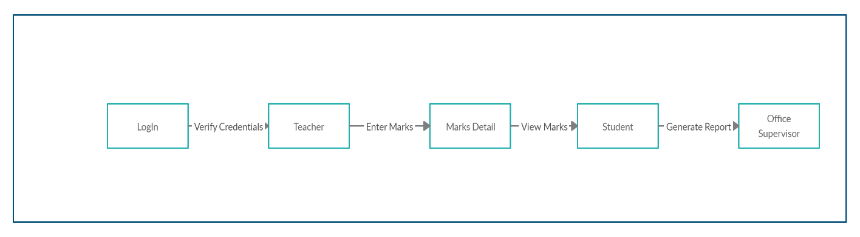
Types of Cohesion and Coupling to be achieved
Data Coupling : The aim is to enforce data coupling where no extraneous data is to be passed as a parameter , the arguments should be homogeneous and every function should have one entry point and only one exit point. This is achieved in central transform modules
Functional Cohesion : The aim is to ensure functional cohesion where every module is responsible for performing a specific task. Every module takes an individual action and calls another function if it requires to perform any other task.

Slide 55
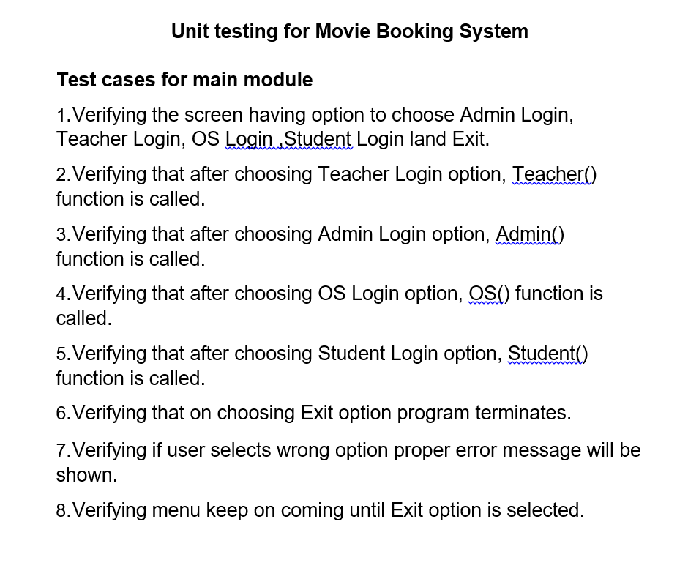

Slide 56
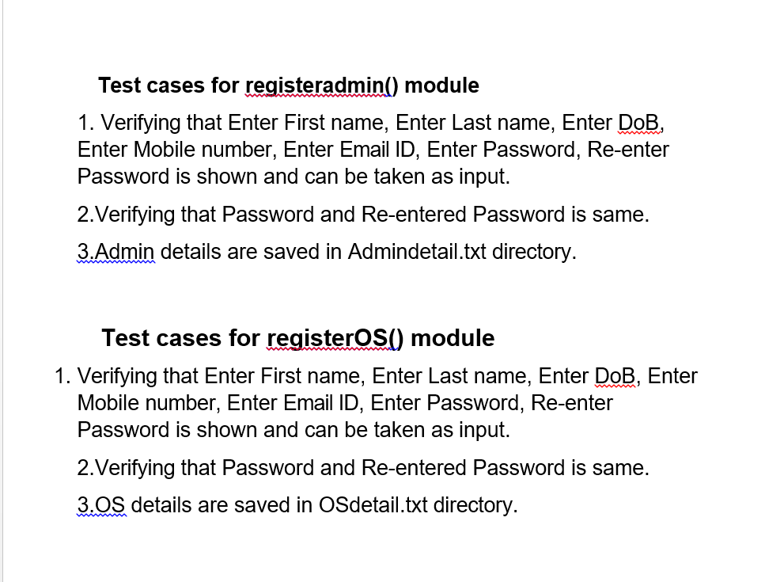

Slide 57
INTEGRATION TESTING
The objective is to take unit tested components and build a program structure that has been dictated by design. Integration testing is testing in which a group of components are combined to produce output.

Slide 58
FUNCTIONAL TESTING
The objective is to take unit tested components and build a program structure that has been dictated by design. Integration testing is testing in which a group of components are combined to produce output.

Slide 59
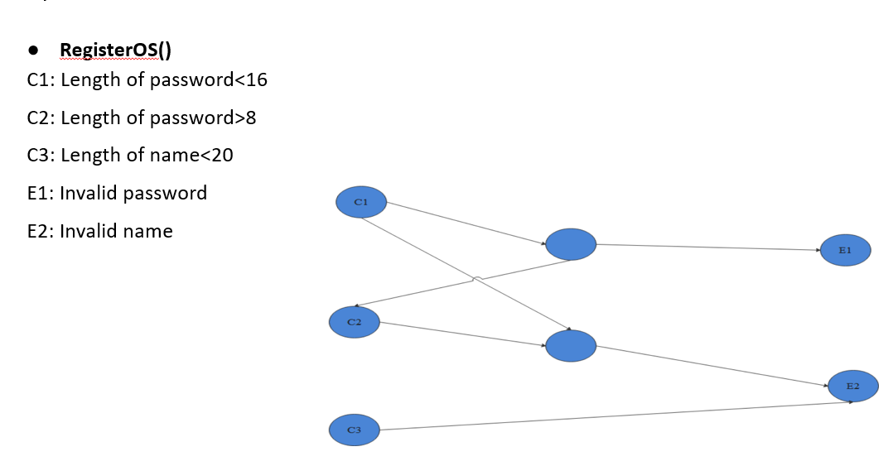

Slide 60
C1 | 1 | 0
C2 | 1 | 0
C3 | X | 1
E1 | 1
E2 |  | 1
Testcases
1: Length of password<16
2: Length of password>8
3: Length of name<20, Length of password<16

Slide 61
STRUCTURAL TESTING
Structural testing focuses specifically on using internal knowledge of the software to guide the selection of test cases.

Slide 62
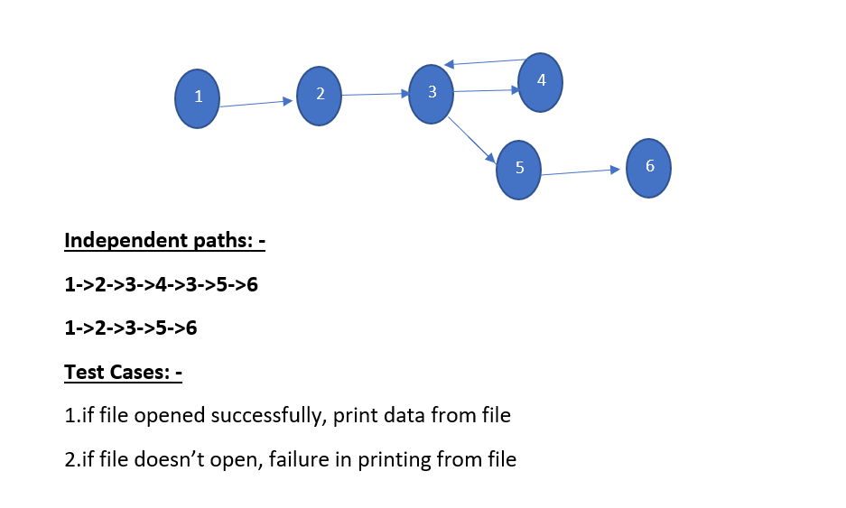
Module: View result
1.LET file_pointer view
LET viw
2.View=fopen(“result.txt”,”rt”)
3.WHILE(viw=fgetc(view)!=EndOfFile)
4.PRINT viw
5.While terminate
6.Close view

